Slide 1
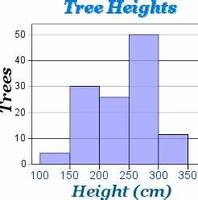
5 Questions
From the histograph to the right,
What was the highest tree?
What was the modal tree height?
What is the mean tree height?
What is the median tree height?
What is the range of tree heights?
Is your INB up to date ?

Slide 2
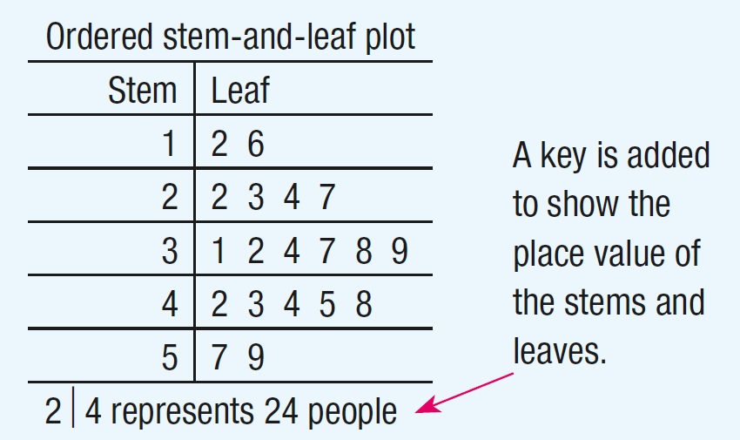
24
7
30
Stem and Leaf Plots
Date
EQ – How do we draw and analyse Stem and Leaf Plots?
What is a Stem and Leaf Plot?
Stem and Leaf plots are used to display a single data set or two related data sets.
They help to show distribution like histograms
Median and mode can easily be read as the data is in order

Slide 3
24
7
30
Stem and Leaf Plots
Date
EQ – How do we draw and analyse Stem and Leaf Plots?
The Data is shows in two parts: the Stem and the Leaf
The Stem is the tens part of the number
The Leaf is the units part of the number
Eg: 26
Look at your data set and see how many numbers you will need in the stem section
Eg: 10, 12, 14, 26, 28, 39, 40, 50, 57, 68
Fill in the leaf section of the plot
How do we draw Stem and Leaf Plot?
2 6
1 0, 2, 4
2 6, 8
3 9
4 0
5 0, 7
6 8
1
2
3
4
5
6

Slide 4
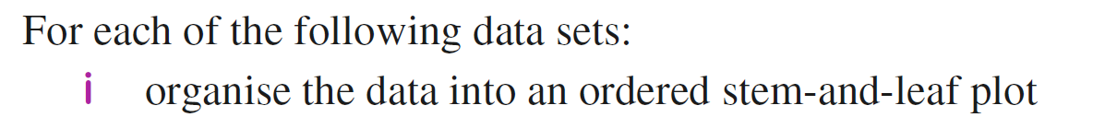
Practice

Slide 5
Practice

Slide 6


Slide 7
Task
Stem and Leaf Plot Worksheet
Summary
Stem and Leaf Plot display______________________________.
To create Stem and Leaf Plots the __________ go on the Stem side and the _______ go on the Leaf side.
Notes:
Stem and Leaf Plot display a single data set or two related data sets.
To create Stem and Leaf Plots the tens part of the number go on the Stem side and the units part of the number go on the Leaf side.

